Slide 1
Emerald Transformers
David Mullaly, Jazmin Elias, Lauren Milsom, Afia Adiba

Slide 2
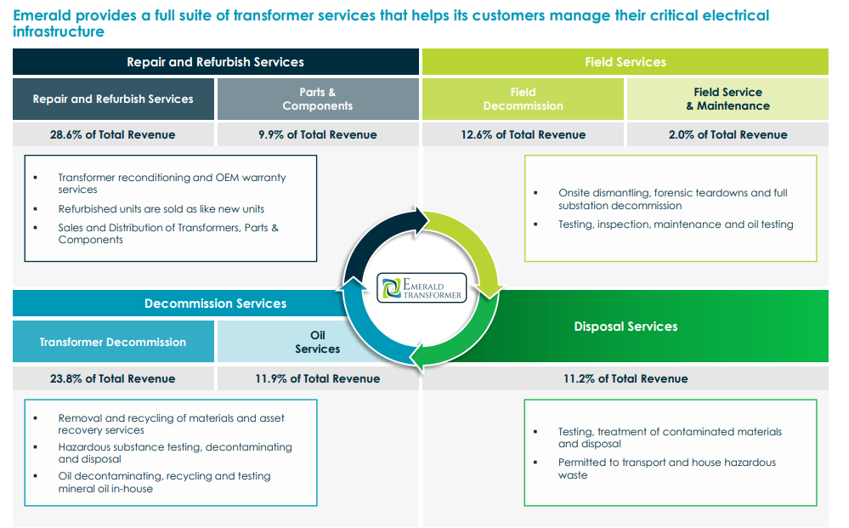
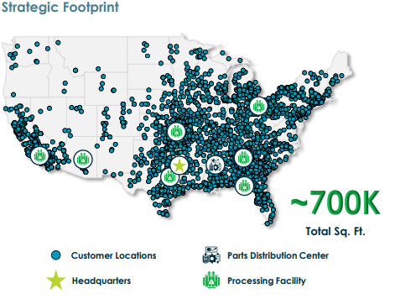
Problem Statement:
Pertinent Data:
Emerald Transformer needs to assess customer density and competitive landscape in the Northeast, West, and Pacific Northwest regions to inform strategic expansion decisions.
Comprehensive US Meter Data
Emerald Pickups
Emerald Customer Meter Data

Slide 3
Possible Lines of Inquiry/Analysis
Market Opportunity Assessment
Competitive Landscape
Expansion Prioritization
Key competitors
Competitive advantage
Market share
Expected ROI
Investor-Owned Utilities
Northeast, West, Pacific Northwest
Data Center service
Field services growth opportunities
Identify highest potential customer density areas

